Slide 1







Slide 2

TABLE OF CONTENT
CHAPTER PAGE NO.
Introduction on Project……………………………………… 03
History on Car Rental System…………………........ 04
Objectives……………………………………………………………….. 05
ER Diagram…………………………………………………………….. 06
Screenshots and Output……………………………………. 07-14
Customer Details…………………………………………………...15
Future Scope………………………………………………………….. 16
Conclusions…………………………………………………………….. 17
Bibliography………………………………………………………….... 18

Slide 3

INTRODUCTION

Slide 4
Car Rental System is a web based platform which creates opportunities for your company.
Latest software makes possibilities to succeed your car rental business, tasks, also keep record their routine operations and receive detailed reports.
Car rental management system is a self sustaining system which is the best opportunity for the people who cannot afford to buy the car in their family.

Slide 5

HISTORY

Slide 6
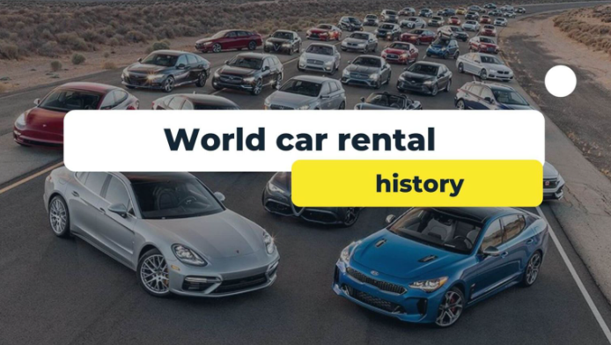
The earliest known example of cars being offered for rent dates back to 1906.
The first known car rental company was Sixt in Germany, that started in 1912 under the name “Sixt Car Cruises and Self Drivers”.
A couple of people started car rental in the US in 1916 & 1918, later taken over by Avis and Hertz; as well as in the UK in 1920, taken over by Europcar.

Slide 7
OBJECTIVES
The objective is to record the details various activities of customer, operator & administrator.
It will simplifies the task & reduce the paper work & the response time of the system is very less.

Slide 8
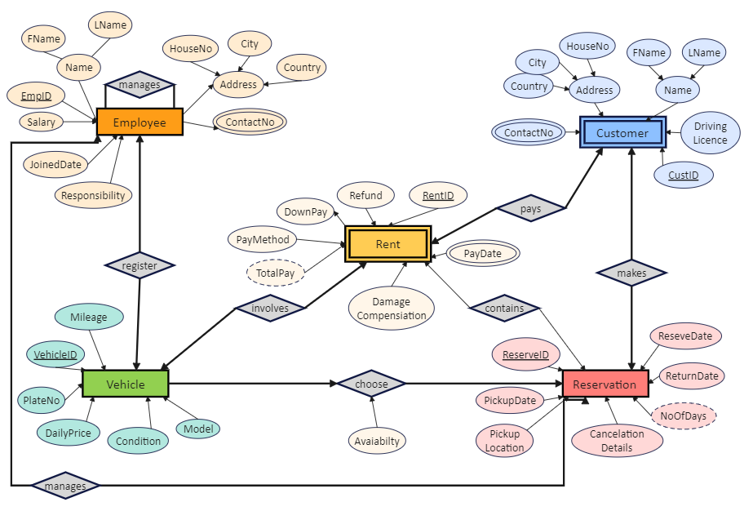
ER DIAGRAM
RESERVATION
CARS
STAFF
CUSTOMERS
RENTAL
CARCATEGORY

Slide 9
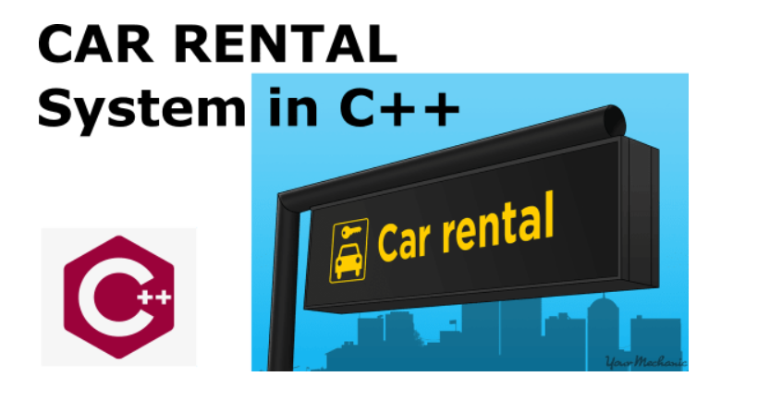

Slide 10
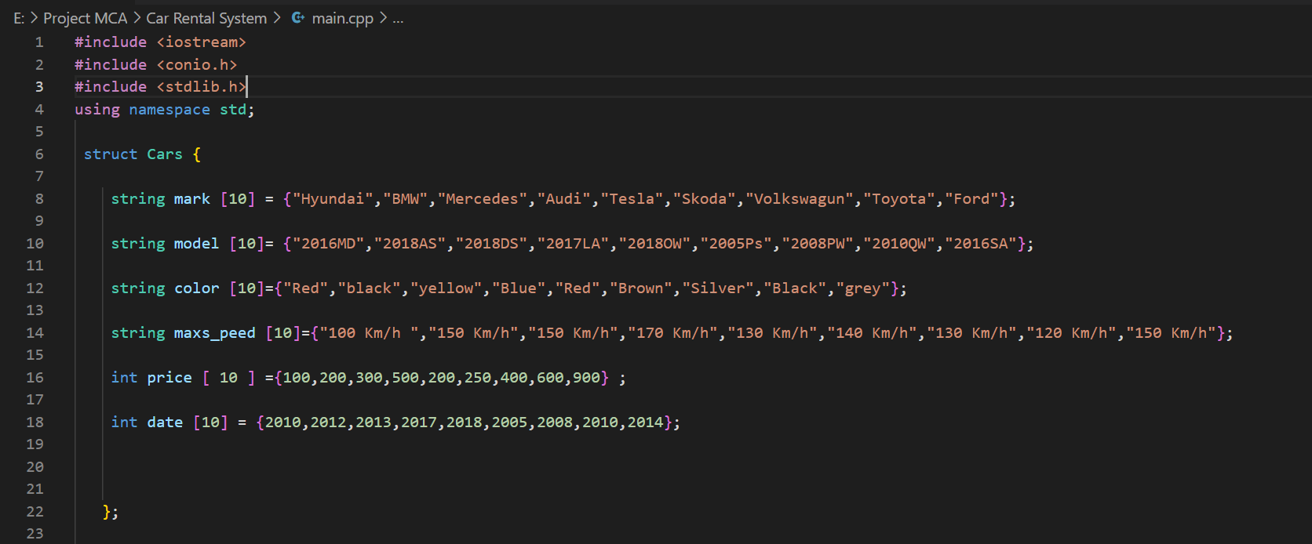
SCREENSHOTS

Slide 11
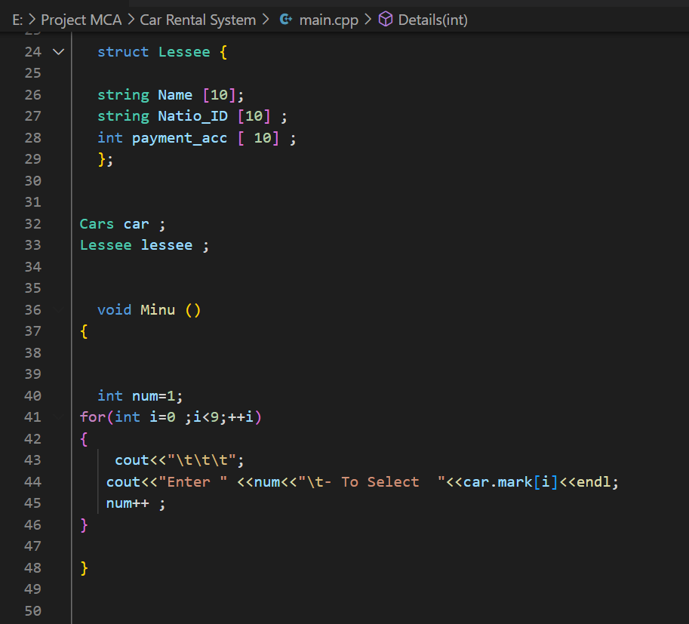

Slide 12
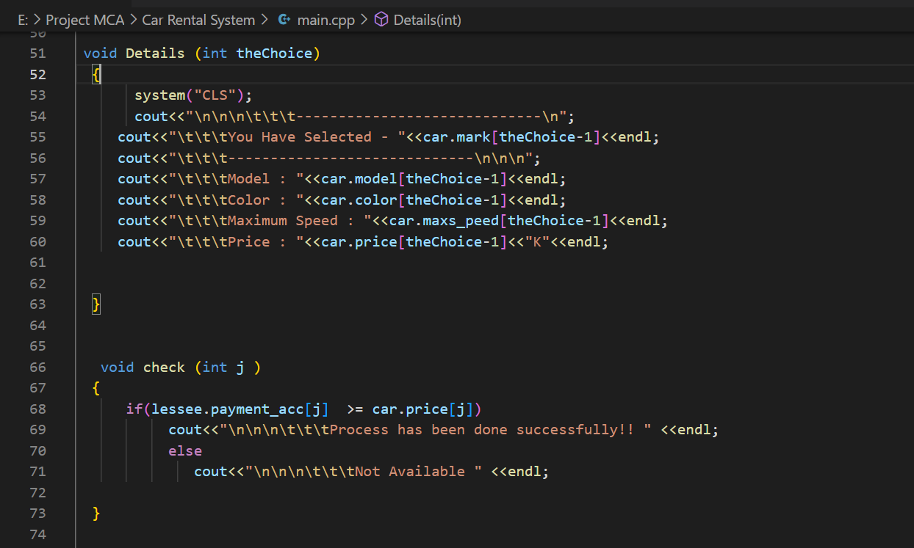

Slide 13
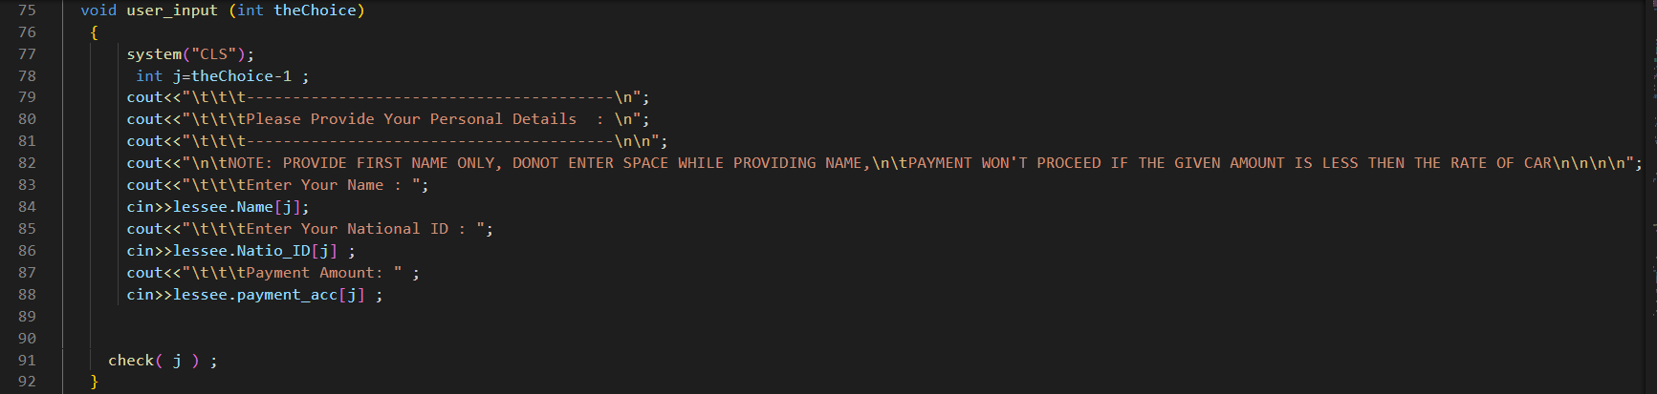

Slide 14
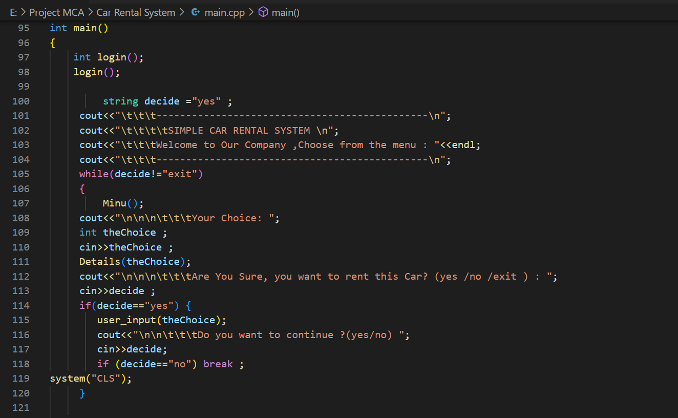

Slide 15
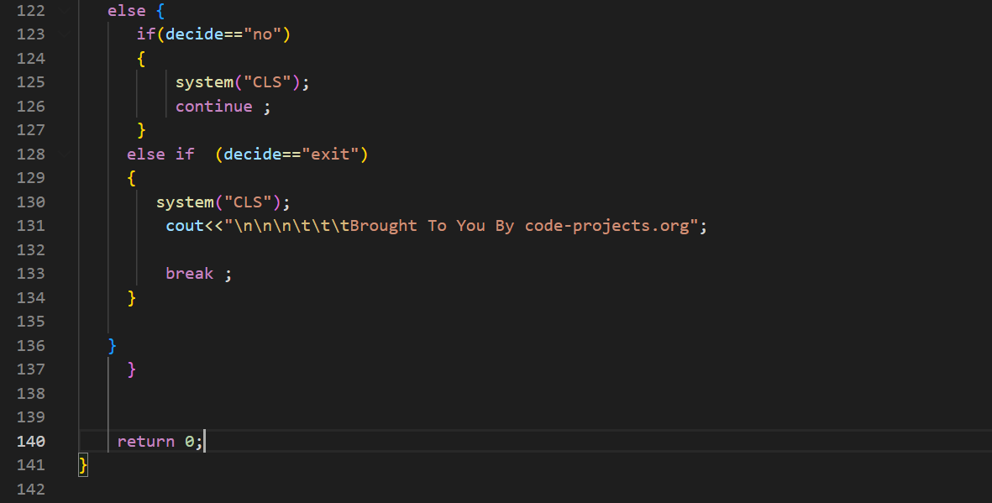

Slide 16
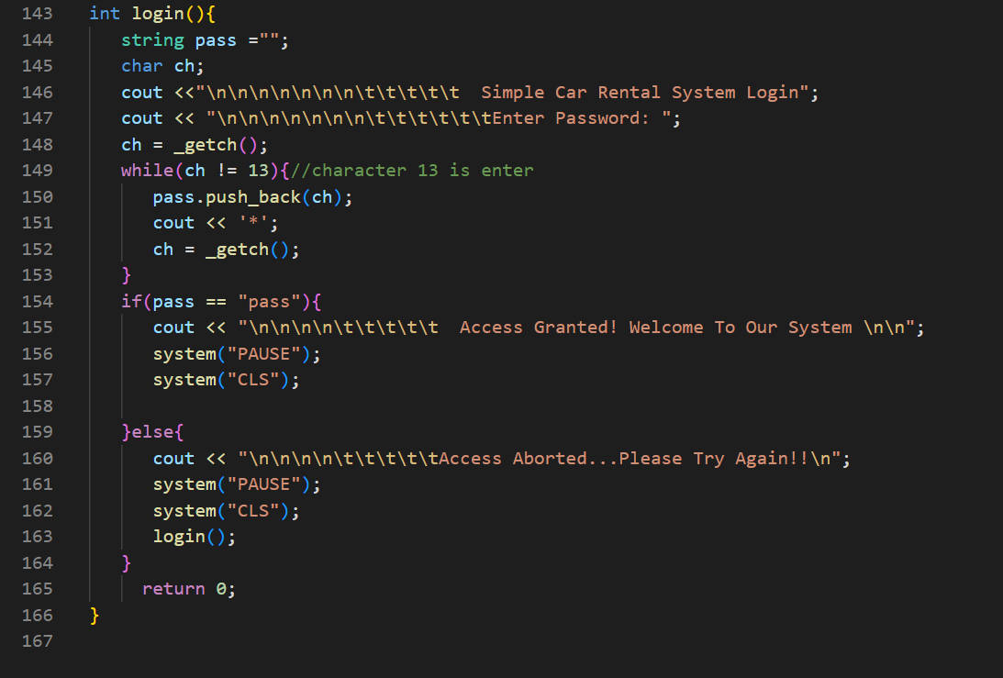

Slide 17
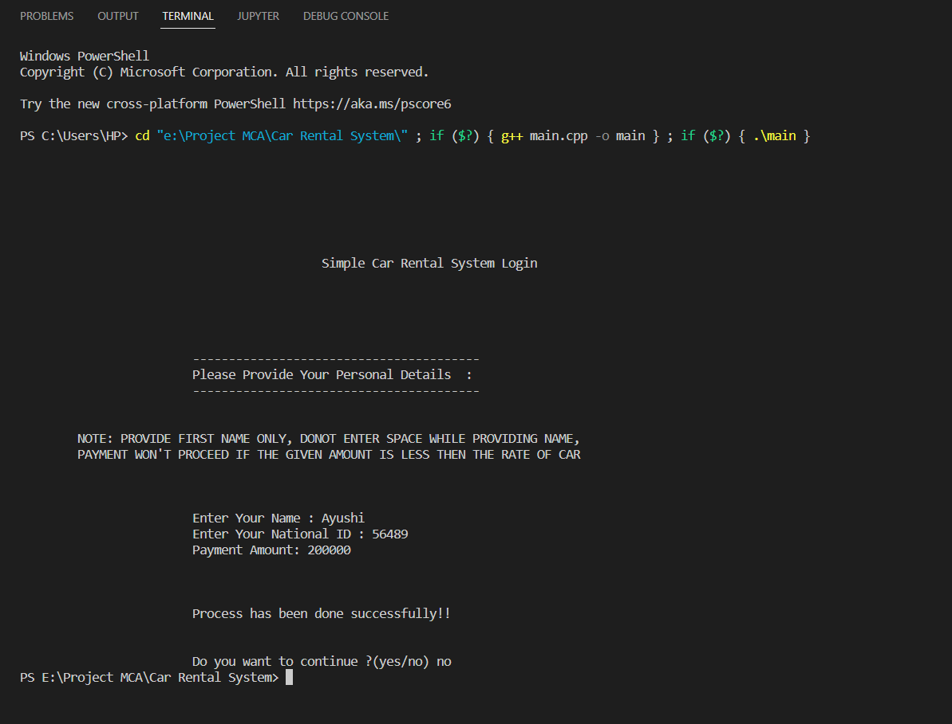
OUTPUT

Slide 18

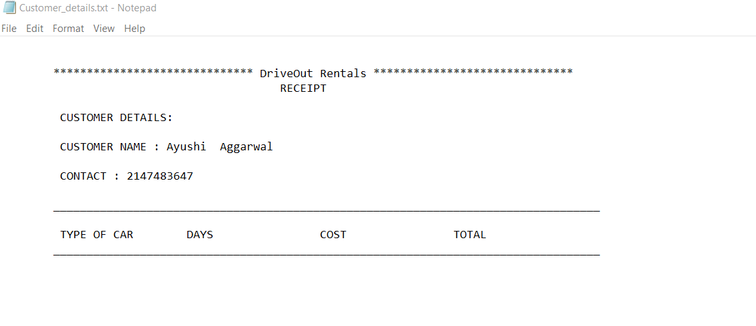
CUSTOMER DETAILS

Slide 19

FUTURE SCOPE
It may help in collecting perfect management in details.
In a short period of time, the collection will simple and sensible.
It helps in reducing time and cost.

Slide 20
CONCLUSIONS
Our aim is to provide a very user-friendly customer registration system who want to take car for rent.
Nowadays, customers can Booking cars online have the car brought to their door step once the customer is a registered member or go to the office to pick the car.

Slide 21
BIBLIOGRAPHY
https://en.wikipedia.org/wiki/Car_rental.
https://www.lovelycoding.org/car-rental-management-system-project-for-final-year/.
https://www.myrentsoftware.com/future-growth-opportunities-car-rental-industry/.
https://www.edrawmax.com/templates/1004799/.

